Slide 1
Sensor Fusion Toolbox for Rocket Motion
Luke Aagaard, Kian Jamal, Nathan Tardy, 4/11/2024

Slide 2
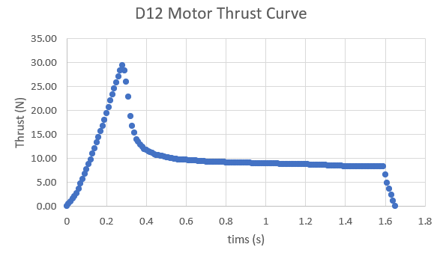
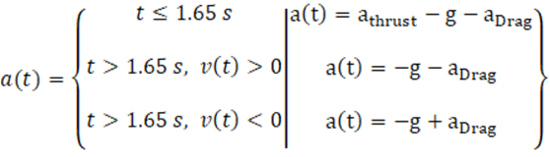
Data Generation
1-D interpolation (interp1) Aerotech D12 Thrust curve using simulation time (thrust curve data taken from thrustcurve.org).
Three-axis Inertial Measurement Unit data simulation outputs simulated noisy accelerometer data
04/10/2024
Luke Aagaard
2

Slide 3
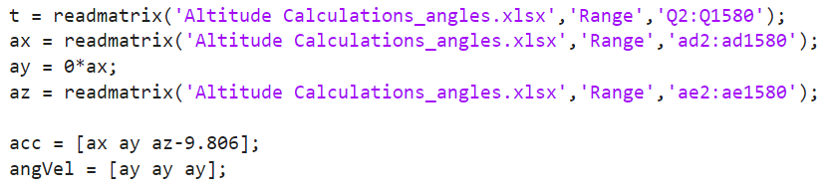
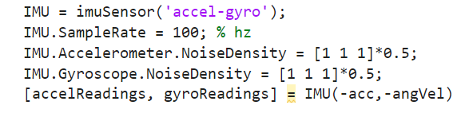
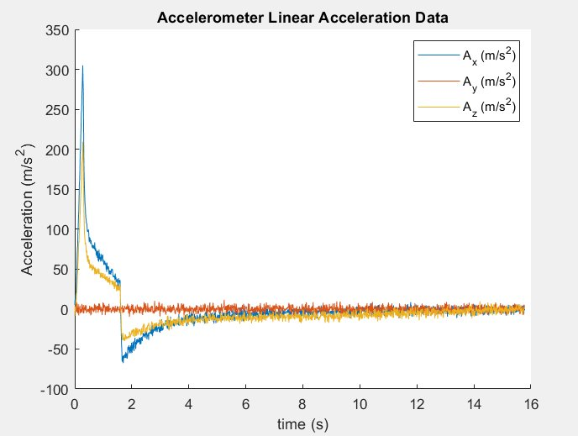
Data Generation
MATLAB
Extracts Data from Excel file and inputs to IMU data simulation function
Note that IMU internally accounts for gravity
04/10/2024
Luke Aagaard
3

Slide 4
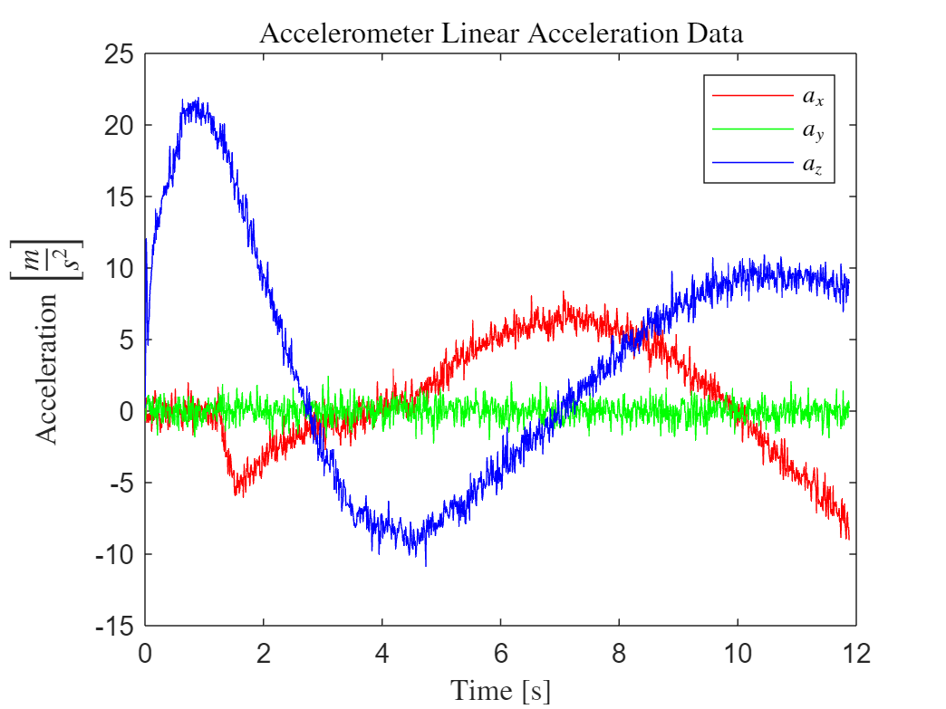
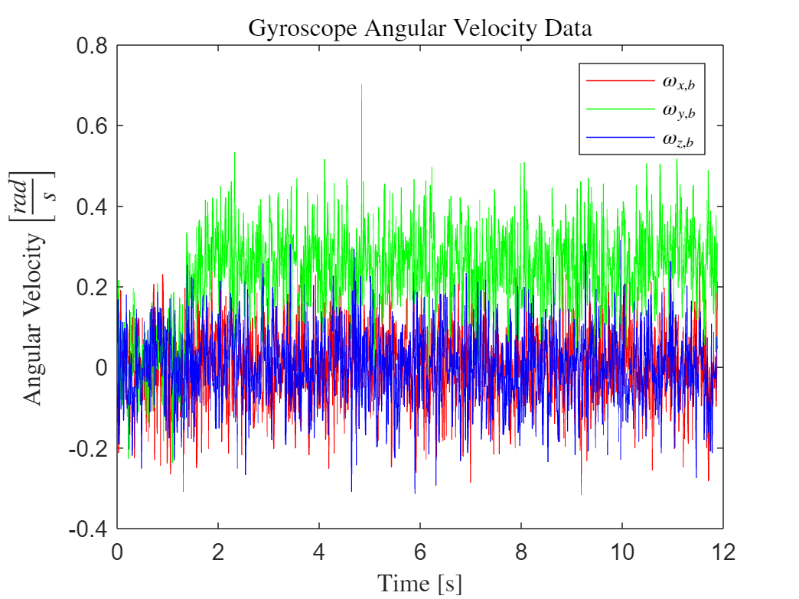
Data Processing
Angular velocity along body axes
Input: raw (noisy) data from virtual sensors
Only really 1 non-zero component due to nature of the motion
No yaw
No roll
Linear acceleration along body axes
4/9/2024
Nathan Tardy
4

Slide 5
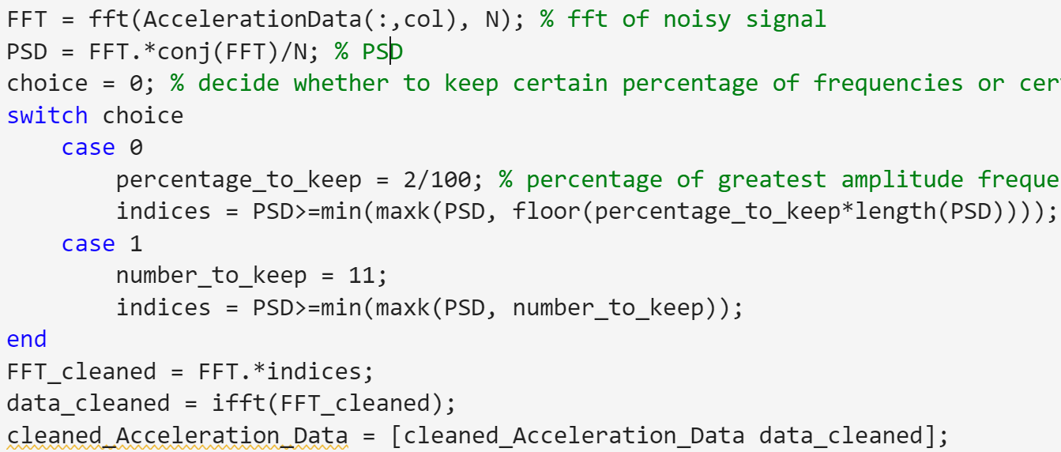
Data Processing
Method: FFT on noisy data (HW 4)
4/9/2024
Nathan Tardy
5

Slide 6
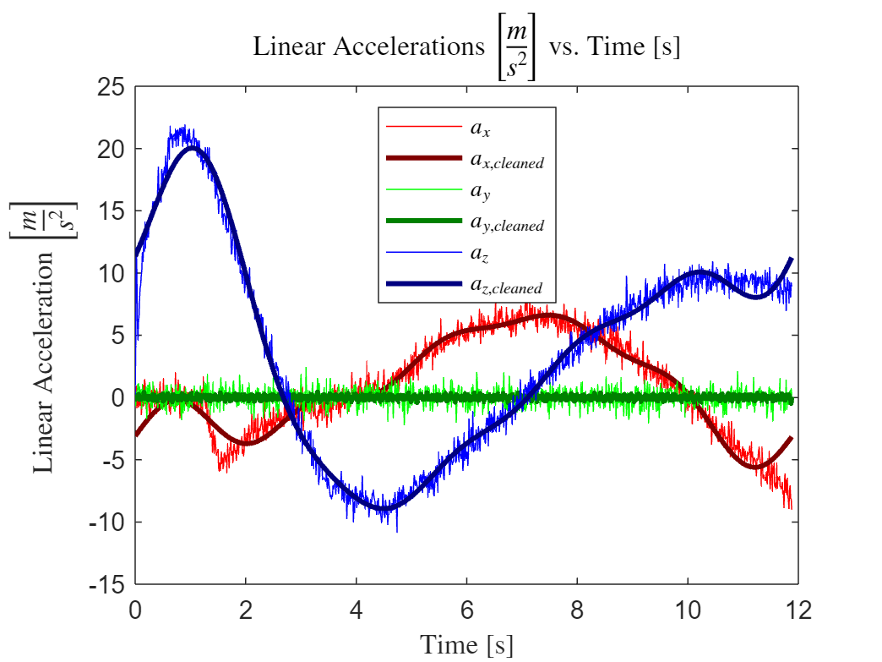
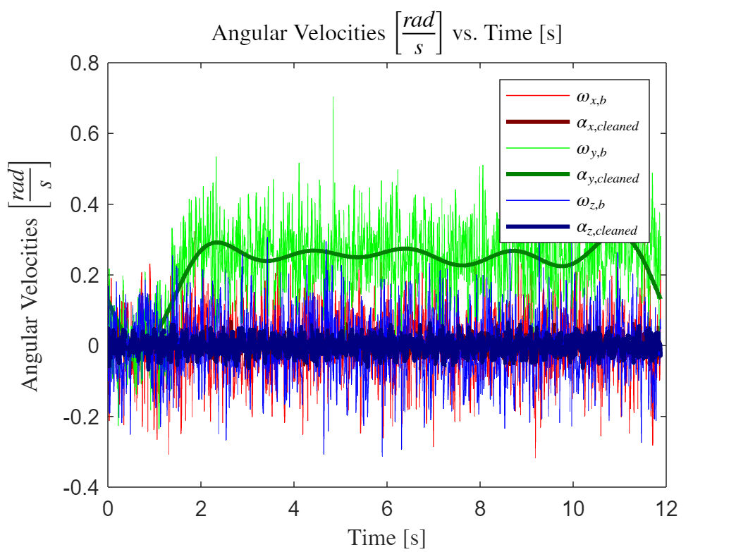
Data Processing
Thin lines: noisy signal
Thick lines: cleaned signal (n = 11)
4/9/2024
Nathan Tardy
6

Slide 7
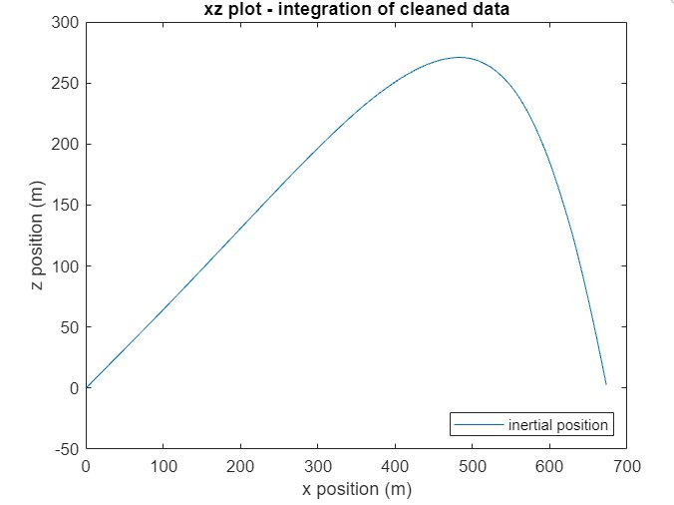
Data Simulation
Kian Jamal
7

Slide 8
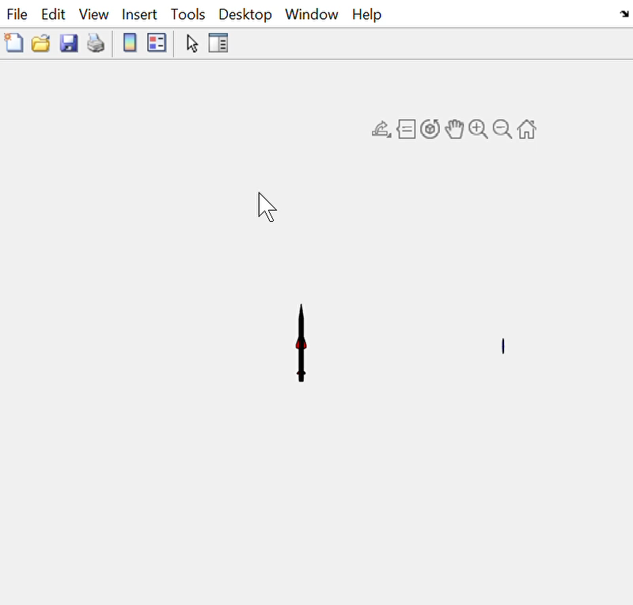
Data Simulation
Kian
8

Slide 9
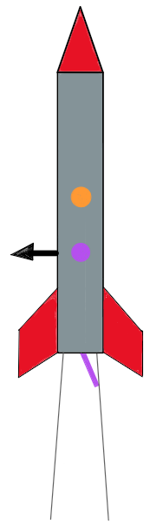
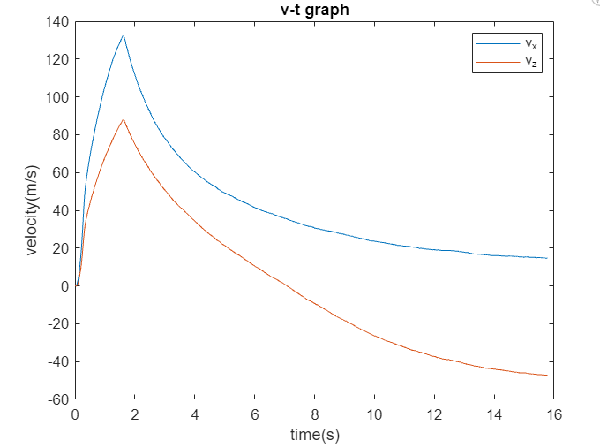
Data Simulation
Kian Jamal
9

